Slide 1

TRANSFORMING AGRICULTURE THROUGH ENERGY AND TECH

Slide 2
THE PROBLEMS WE ARE ADDRESSING
01
02
03
POWER SCARCITY
ENVIRONMENTAL POLLUTION
SOIL INFERTILITY

Slide 3

ECO-FRIENDLY
PRODUCTS
HEALTHY COOKING ALTERNATIVE
AFFORDABLE AND CLEANER ELECTRICITY
PRODUCES BETTER ALTERNATIVE TO CHEMCIAL FERTILIZERS
AFFORDABLE PRESERVATION AND PROCESSING OF FOOD
INCREASE IN CROP PRODUCTION
WASTE MANAGEMENT (BIO WASTE)
THE SOLUTION

Slide 4
OUR ROAD MAP
IDEA PROTOTYPING AND TESTING
RETAIL OF OUR BIOGAS AND BIO-FERTILIZER
SECURING INVESTMENT AND PARNTERSHIP FOR GOALS.
SETUP OF OUR BIOGAS ELECTRO-STATION AND RETAIL OF OUR ELECTRICITY AND OTHER PRODUCTS
CUSTOMER DISCOVERY STAGE
ENSURING WE MAKE AS MUCH IMPACT AS POSSIBLE
COMMUNITY OUTREACHES ON THE USES AND IMPORTANCE OF BIOGAS WITH ITS BY-PRODUCTS

Slide 5
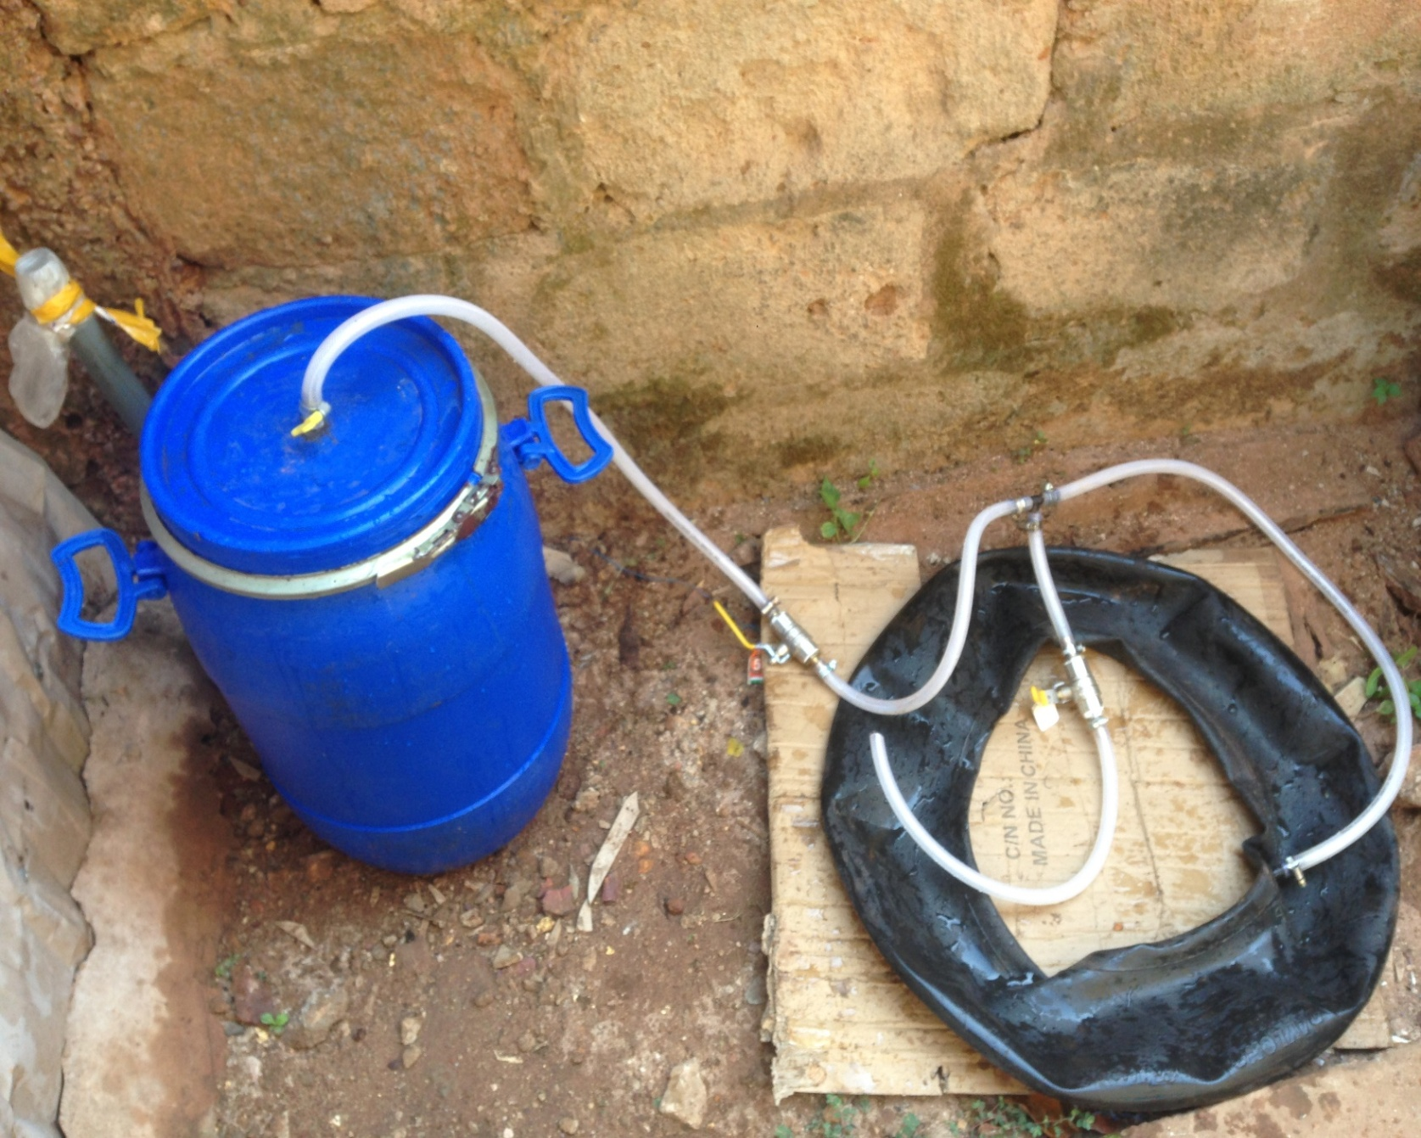
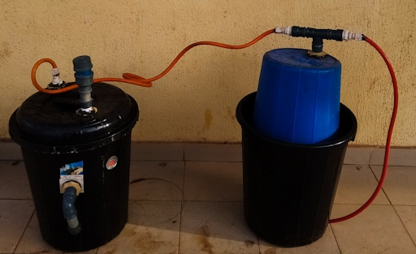
WHERE WE ARE NOW
CURRENT PROTOTYPE
FIRST PROTOTYPE

Slide 6
OUR TARGET CUSTOMERS
HOUSEHOLDS,
FARMERS,
ELECTRICITY DISTRIBUTION COMPANIES,
GARDNERS.

Slide 7
OUR REVENUE STREAM
Maintenance services.
Green-energy Trainings and programs,
Consultancy,
Sales of our biogas, electricity, bio-fertilizer and other products
Sewage disposal services.

Slide 8
SIGNS OF IMPACTS
NEW BUSINESSES AND COMPETITION OPENED IN RELATION TO OUR CREATED NICHE.
01
CLEANER AND AFFORDABLE POWER SUPPLY
02
AFFORDABLE FOOD PRESERVING AND PROCESSING
SYSTERM.
03
04
INCREASE IN CROP YIELD
WASTE MANAGEMENT
(BIO-DEGRADABLE WASTE)
05

Slide 9
OUR COMPETITORS AND OUR ADVANTAGE OVER THEM
Avenam Links Int’l Ltd
By partnering with electricity distribution companies, we tend to cover a larger market and ensure steady power supply
Liquefied petroleum Gas Producers
Producers of Chemical fertilizers
Our biogas produces the least greenhouse gas emission
Our bio-fertilizers are rich in NPK and easily absorbable by plants.

Slide 10
OUR PROPOSED KEY PARNTHERS
TRINE TECH
Electricity distribution Companies
Waste Management Companies
Farmers
Market unions
National Energy and Research Development centre.(UNN)
Investors

Slide 11
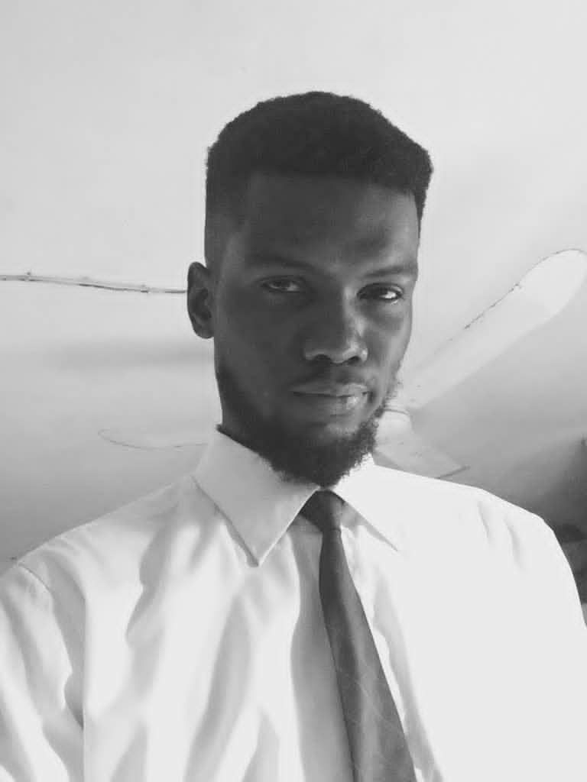
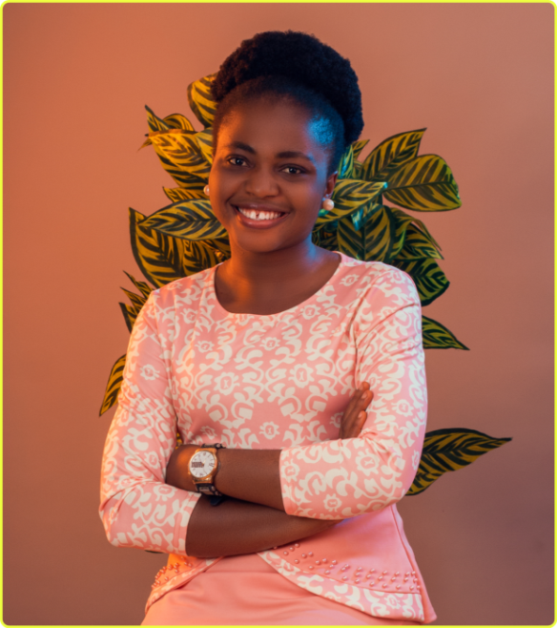
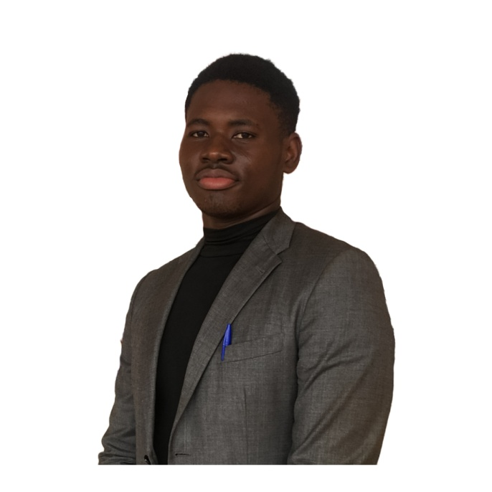
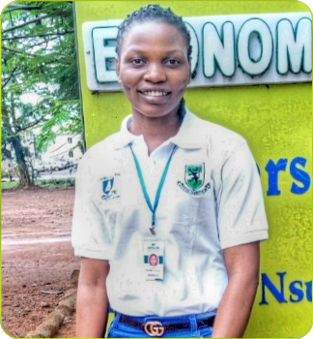
OUR TEAM
GLORY AMADIFE
CO-FOUNDER
MMERICHUKWU ANOSIKE
CO-FOUNDER
JOY OGUMBA
RESEARCHER / MEDIA OFFICER
MADU A. DANIEL
STARTUP MENTOR

Slide 12

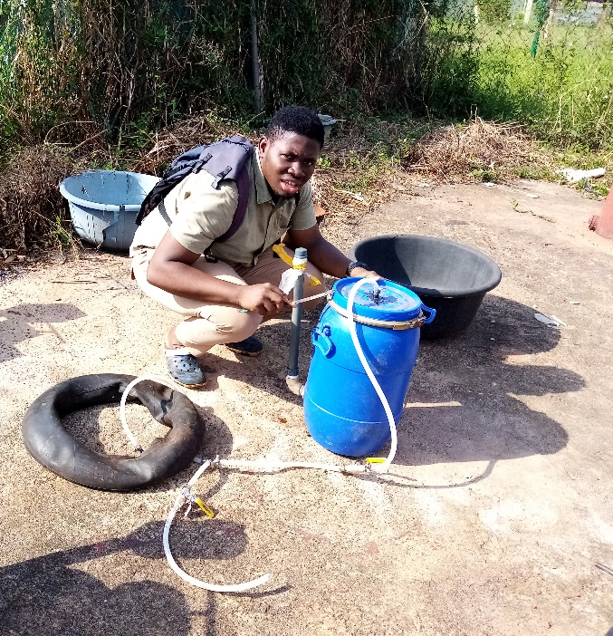
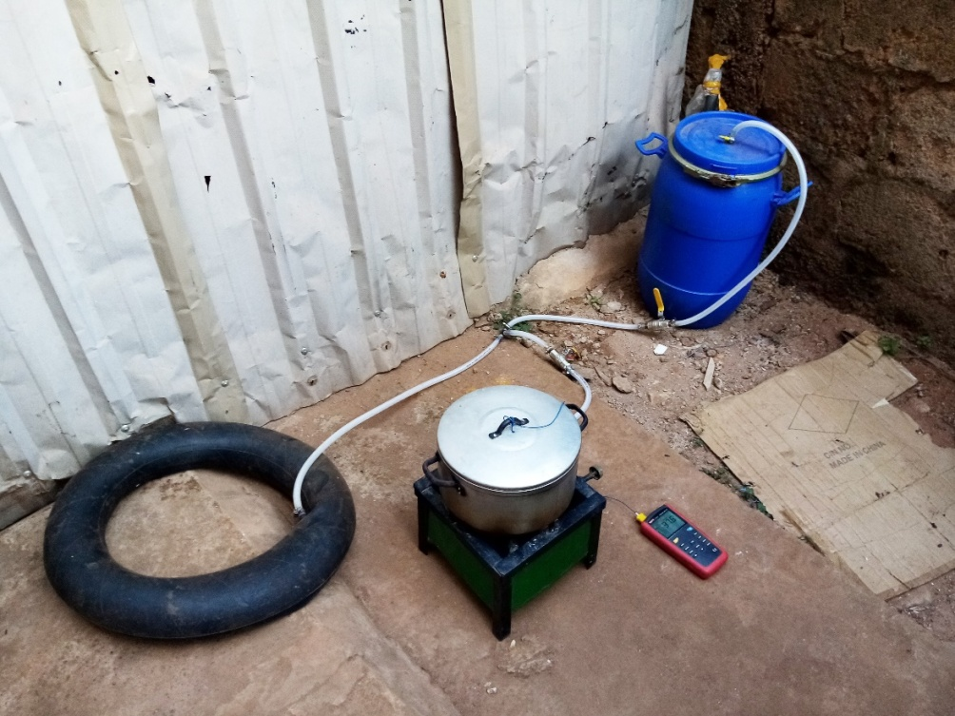
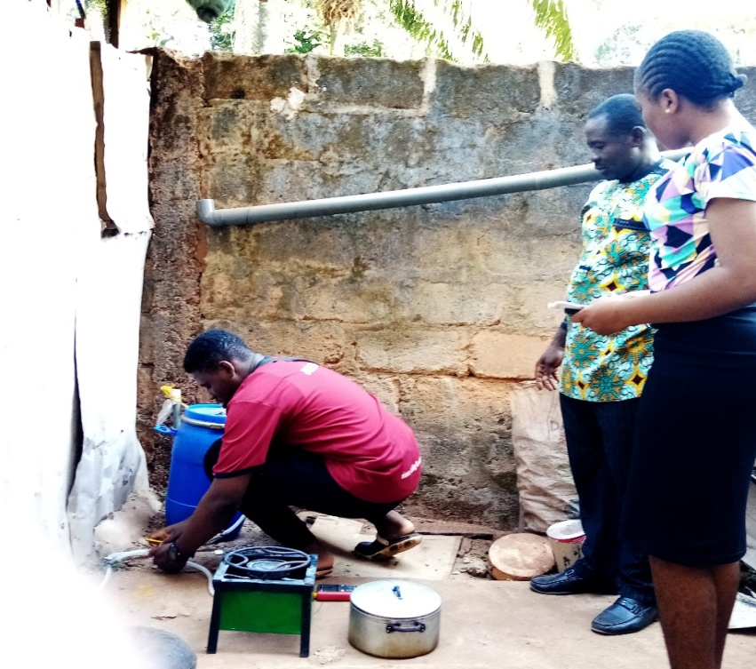
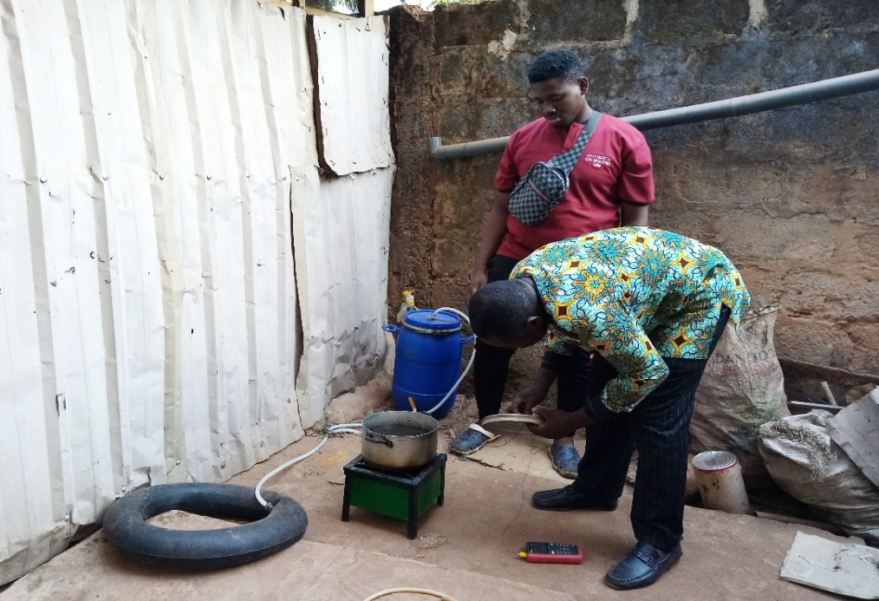
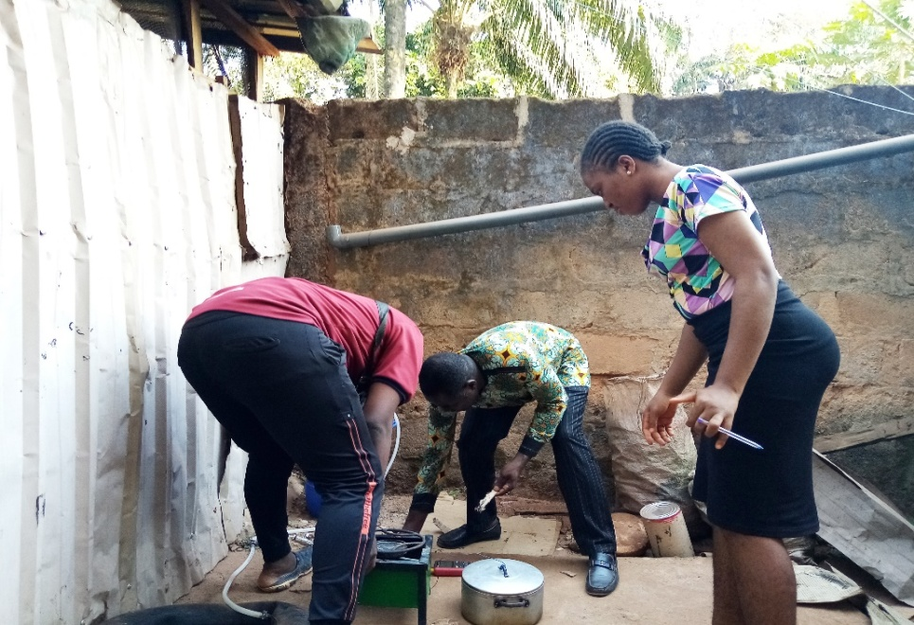
CURRENT PROGRESS IN PICTURES

